Slide 1

Predictors of gender disparity in Text-based generative AI systems adoption
WID DATATHON 2024
1

Slide 2




The Team
Valery Wafula
Experienced Data Scientist
Statistical Data Analyst
Patricia Irungu : Data Scientist
Chelsea Kiunga
Telco Engineer,
Data analyst, Videographer,
Web Developer.
Millicent Nyuguto
Research Analyst
2

Slide 3
Problem
Statement
Generative AI systems are known to perpetuate and exacerbate existing human biases and harms. Studies have confirmed the existence of a notable gender gap in the usage and exploration of Generative AI despite its significant advancements.
Compared to women, men are more likely to experiment and adopt Generative AI tools; women remain underrepresented in this rapidly evolving field. This gender inequality has implications for both individual opportunities and societal progress.
This study aims to determine the key factors that contribute to this disparity in text-based Generative AI tools adoption.

Slide 4

Approach
We noticed that there is a lack of representation in the information available online about GPT usage by the African populace.
We decided to collect data from Africans, so we developed a questionnaire to address this lack of representation and explore the rate of adoption of GPTs by the African race.
We intend to continue this research and improve our questionnaire to include areas where people state their race, their gender, location, industry and whether or not they have know/have used GPTs or AI in general.
This is because we noticed that some of the people we shared the questionnaire with have never heard of/interacted with GPTs hence they did not respond to our questionnaire.

Slide 5







Stakeholders/Audiences
Women in Technology Groups
Researchers and Academics
Government Agencies
Non-Governmental Organizations
Technology Companies
General Public
Educational Institutions

Slide 6
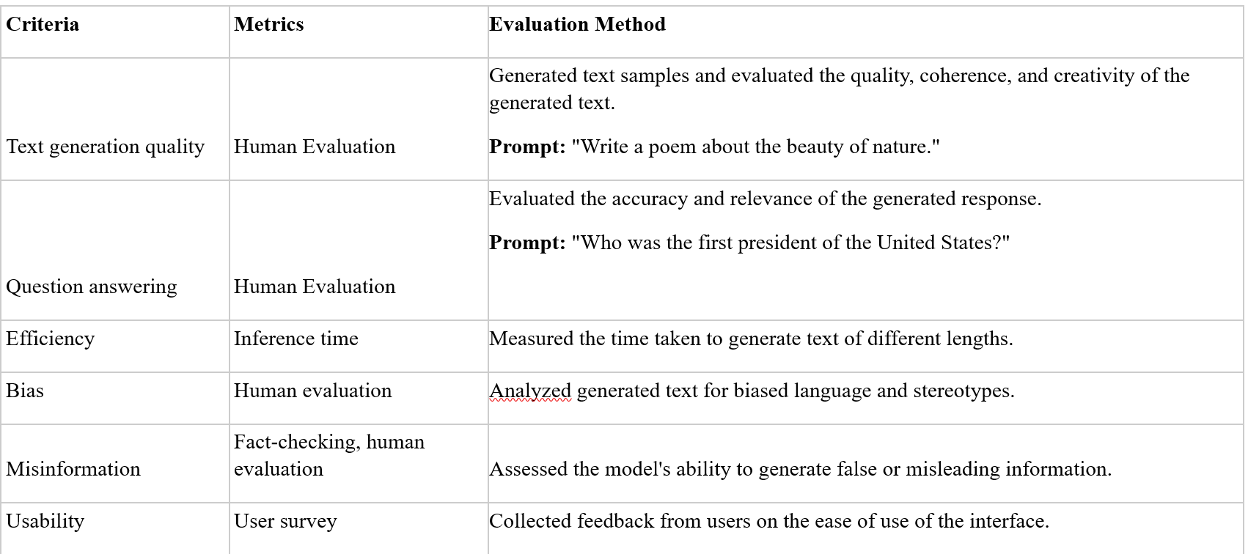
We conducted a comprehensive analysis of the text-based generative AI systems to gain a deeper understanding of its strengths and weaknesses.
Evaluation Framework for text-based GenAI system's strengths and weaknesses

Slide 7
Strengths, weaknesses, and best use cases
Platform | Pros | Cons | Best Use Cases
GPT-4 | Exceptional language understanding, creative writing | Expensive, potential for bias | Content creation, research, customer service
LaMDA | Strong conversational abilities, factual accuracy | Limited creative output | Chatbots, customer support
Jasper AI | User-friendly interface, marketing-focused | Can be repetitive, limited depth | Marketing copywriting, social media content
Gemini | Exceptional language understanding, code generation, image generation | Requires significant computational resources | Content creation, research, code development

Slide 8

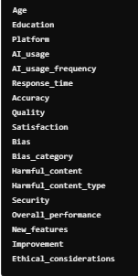
Primary data and variables used
The sample consists of 115 respondents (n = 115); 60 females and 55 males.
The link to the data is :
https://docs.google.com/spreadsheets/d/1gcYrbeBhQJI_FC4tGKoPNa5-MWmhIhQaw1pW59YXOmM/edit?usp=sharing
Data

Slide 9


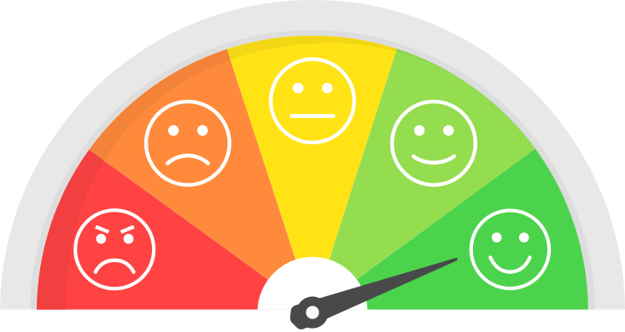
Bias and Fairness
31% of our respondents experienced some form of bias while using the GenAI systems.
Location bias was the most frequently experienced, followed by a language bias.
32% of our respondents encountered harmful content when using the AI platforms.
Misinformation was in the forefront at 87%, followed by deep fakes and hate speech at 6.5% each.
57% of our respondents are not confident in the safety of their personal information with the GPTs.
Female: 52%
Male:
48%
Demographics
Most of our respondents are well educated, with those holding a Bachelor’s degree leading at 71%. Finally, 43% of our respondents are aged between 25 and 34, followed by the ones aged between 18-24 at 38%.
Satisfaction score
Across the board, 67% of respondents were satisfied, 17% were very satisfied and 14% were neutral with the performance of the GPT platforms.

Slide 10
Research Questions
Are there significant differences in platform usage between genders?
What factors contribute to the gender gap in generative AI usage?
How do perceptions of generative AI differ between men and women?
Does user trust in AI platforms impact their platform usage?

Slide 11

The chi-squared test identified if there are significant differences in platform usage between genders.
Logistic Regression was used to predict generative AI usage based on a set of predictor variables (age, education, platform type, quality, and accuracy).
The chi-squared test determined if there are significant differences in ethical concerns (bias, harmful content, security) between genders.
Textual analysis analyzed the open-ended responses to identify recurring themes and keywords related to stereotypes and biases.
Inferential Statistics

Slide 12
Key Findings
i. Gender Gap in AI Usage:
Significant disparity influenced by platform preference, response quality, education, and age.
Higher quality and Chat GPT usage correlate with increased adoption; older age and education enhance usage.
ii. Security Concerns:
Women are more concerned about personal data safety, affecting adoption.
Both genders perceive similar levels of harmful content and biases in AI.
iii. Misinformation Concerns:
Misinformation is the most common harmful content, with rising awareness of deepfakes.
Minimal references to hate speech indicate a need for further study.
iv. Location Influence:
Geographic factors impact AI training, leading to potential bias and inequities.
Key dimensions include location, language, culture, gender, and race/ethnicity.

Slide 13
Limitations
Limited Sample Size: The number of respondents interviewed was not as extensive as we intended to reach.
A large part of our respondents are white-collar workers, which leaves out the rest of the population who are not formally employed.
The majority of our respondents are African, we are aware that it is not Africans only who reside in the continent, and as such there could be some bias.

Slide 14
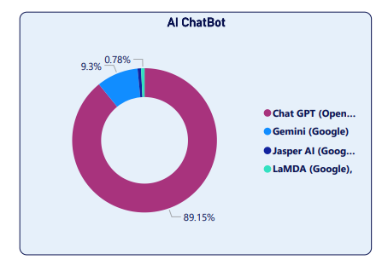
VISUALIZATIONS

Slide 15

CHAT GPT VS GEMINI

Slide 16

Recommendations
Diversity & Inclusion: Train AI on diverse datasets and engage varied users during development to identify biases.
Fact-Checking: Implement robust mechanisms to detect misinformation and deepfakes.
Privacy & Security: Prioritize user privacy and data security to build trust.
Personalization: Allow users to customize their AI experience based on preferences.
Continuous Improvement: Conduct ongoing research and monitor AI systems to adapt to societal changes.
User-Friendly Design: Ensure platforms integrate seamlessly into workflows with high-quality responses.
Combat Misinformation: Focus on addressing misinformation and explore educational initiatives related to deepfakes.
Bias Audits: Conduct regular audits to identify and mitigate biases using diverse evaluation teams.

Slide 17
Actionable Insights
Throughout the project, we realized the need for databases on AI usage within Africa. Institutions and individuals have the opportunity to create and make available. This would be helpful to anyone looking to research further on AI in the African context.
To empower more women to use Gen AI, we propose the following.
Community-Building: Organize AI communities and meetups specifically for women to foster a sense of belonging and support.
Role Models: Highlight successful women in AI to inspire others and challenge stereotypes.
Accessible Resources: Develop user-friendly AI tools and resources that are inclusive and easy to learn.
T

Slide 18
THANK YOU !

